Slide 1
YOLOv8 Black Hole detection
By Juan Diaz, Ryan Nieraeth and Juan Rosas

Slide 2
About Yolo
YOLO (You Only Look Once) is an efficient detection algorithm and it's very fast making it great for real-time object detection.
Also, it is very easy to port onto different hardware making it incomparable to similar products.
The training is easier due to the decoupled classification and regression loss functionality
Used in:
Self driving cars
Agricultural Technology
Medical Imaging
Surveillance

Slide 3
About our project
Assigned black hole dataset
Obtained images from:
NASA
NASA-JPL
NASA-Chandra X-Ray Observatory @ Harvard
ESA/Hubble
Windows Performance Analyzer, a system profiler
YOLOv8m

Slide 4
Why YOLOv8
The developers offer generational changes and improvements to the model
Stems from the pytorch developments from YOLOv5 by Ultralytics
Higher accuracy than previous models and can be trained faster
More intuitive training

Slide 5
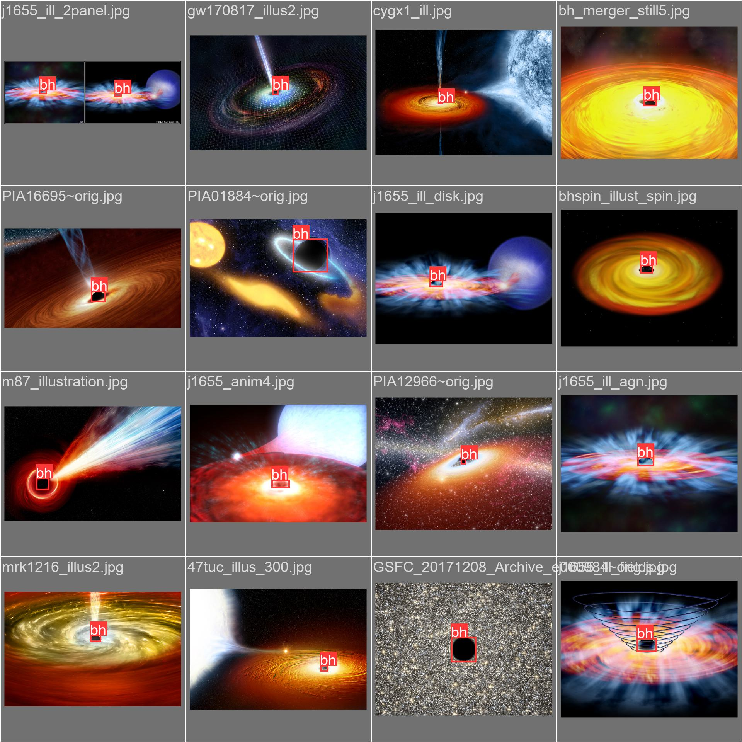
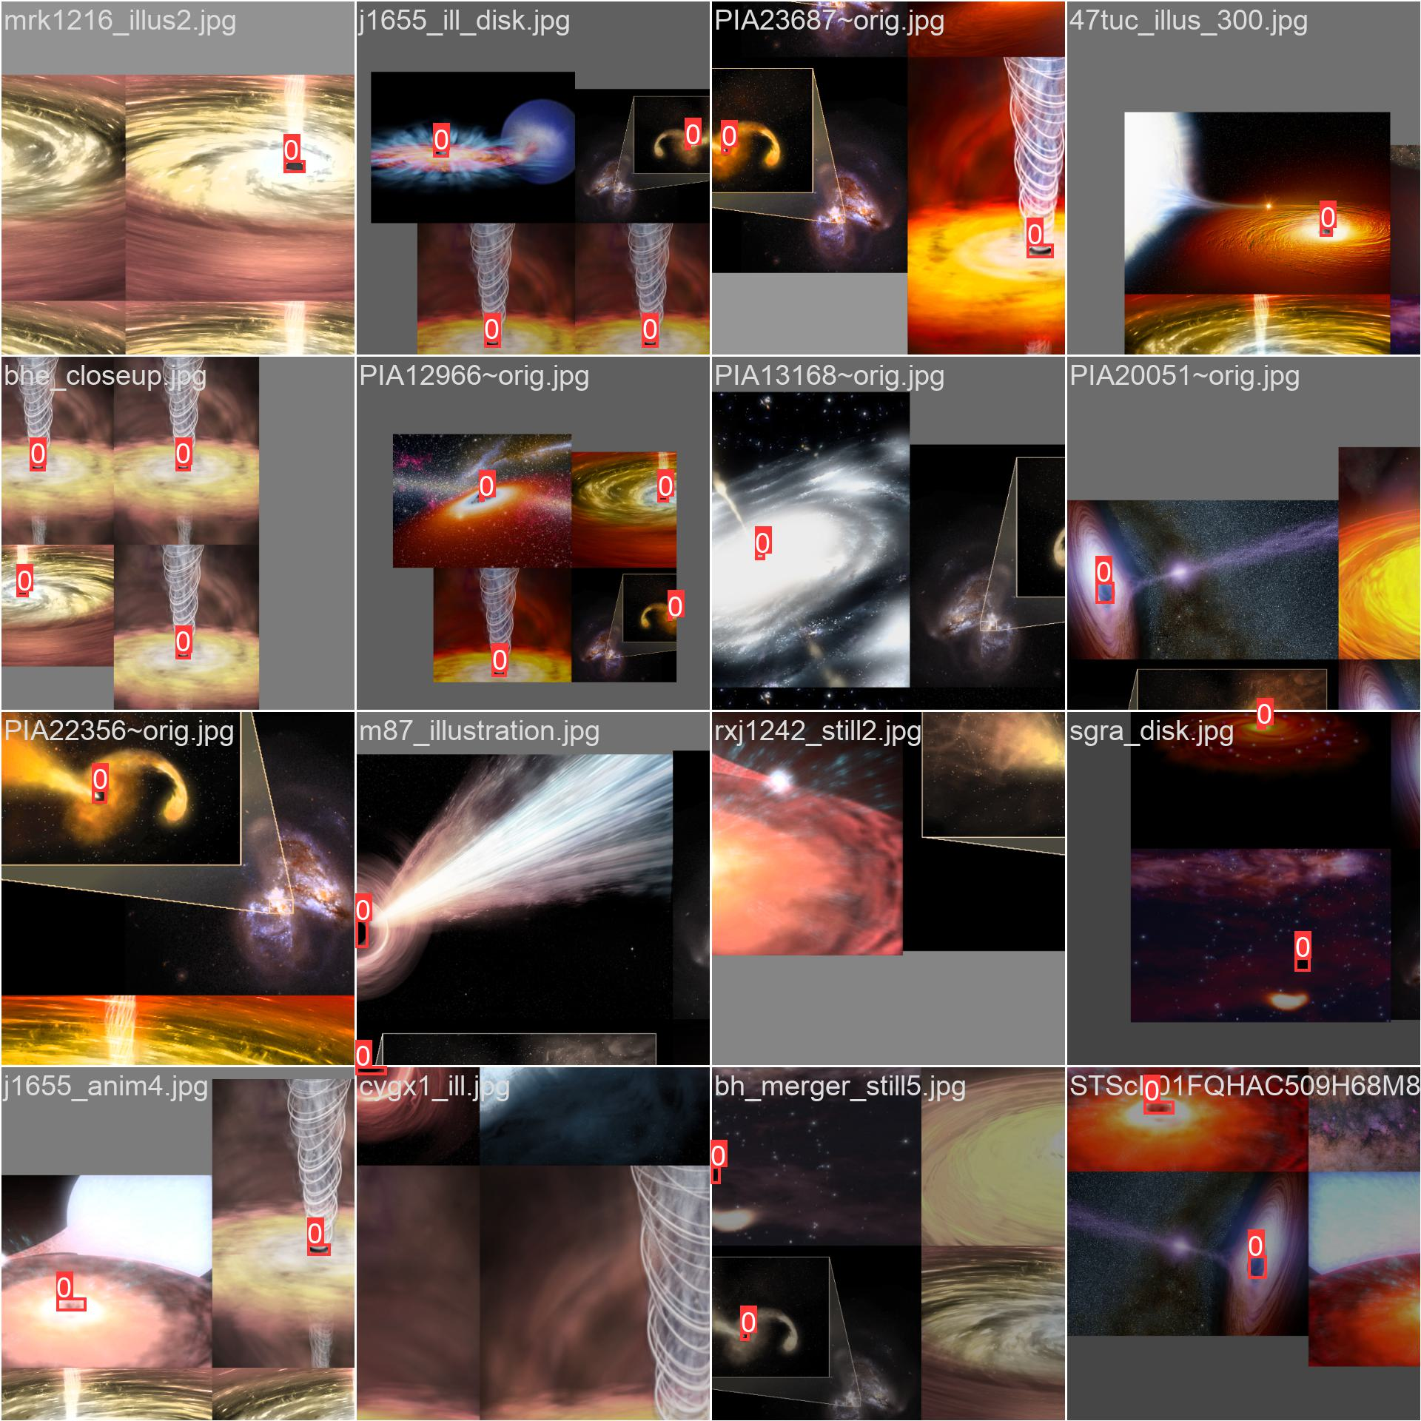
Training the model
Gather the dataset from various sources
Train it using the detect mode in YOLO
Validate the data
Test on unseen data

Slide 6
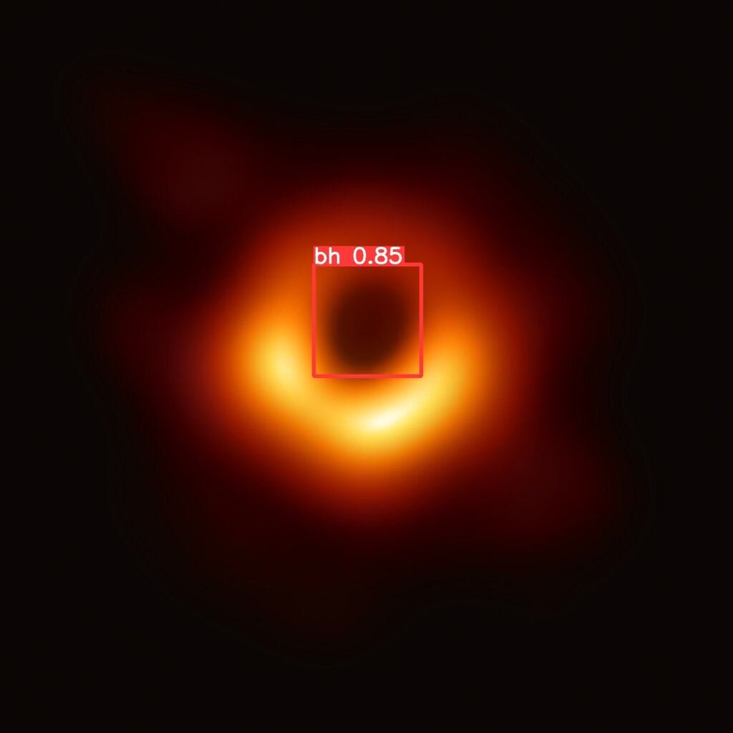
Interesting Results

Slide 7
Benchmarks
Processor Information: Intel Core i5-8350U @ 1.70GHz
Performance Metrics:
CPU Usage:
Average: 8.3%
Peak: 12.0%
Memory Usage:
Average: 89.3 MB
Peak: 110 MB
Power Usage:
Average: 3.99 mA
Max: 18.73 mA
Supply Input: 3V
I/O Activity:
Number of I/O Reads: 334
Number of I/O Writes: 168
*all results were found during the 24s runtime of YOLO

Slide 8
Benchmarks cont.
Processor Information: Ryzen 5 5600u @ 2.30GHz
Performance Metrics:
CPU Usage:
Average: 49.7%
Peak: 60.5%
Memory Usage:
5GB RAM used
Power Usage:
Average: 4.10 mA
Max: 15.32 mA
Supply Input: 3V
I/O Activity:
Number of I/O Reads: 77
Number of I/O Writes: 15
*all results were found during the 24s runtime of YOLO

Slide 9
References
https://blog.roboflow.com/whats-new-in-yolov8/
https://www.jpl.nasa.gov/images
https://esahubble.org/images/
https://github.com/ultralytics/ultralytics
https://www.nasa.gov/gallery/chandra-x-ray-observatory/

